Slide 1
Event Handling

Slide 2
Parameterizing Figures
Non Parameterized Drawing
Setting vertices for every drawing
Not flexible
Hardwired code
Parameterized drawings
Flexible
Pass parameter to the routine and draw families of objects by passing parameter values to the routine.

Slide 3
Mouse Interaction
Knowing activities of the mouse and reacting to it helps in many graphics oriented tasks and also user interfaces. The mouse interaction can be achieved in two ways:
Mouse Buttons
Mouse Motion

Slide 4
Mouse Button
Register a function that will be responsible for handling mouse activities using
glutMouseFunc( mouseHandler )
Parameters of the mouse handler should be as follows
mouseHandler(int button, int state, int x, int y )
The button parameter will receive one of the following values
GLUT_LEFT_BUTTON
GLUT_MIDDLE_BUTTON
GLUT_RIGHT_BUTTON

Slide 6
State parameters
The state parameter will receive one of the following values
GLUT_DOWN
GLUT_UP
x and y are screen coordinates of the mouse pointer
The x value is the number of pixels from the left of the window.
The y value is the number of pixels down from the top of the window.

Slide 7
How to handle handler
In order to see the effects of some activity of the mouse or keyboard, the mouse or keyboard handler must call either myDisplay() or glutPostRedisplay().
Usually the coded inside the mouse handler will check the button and its state and react accordingly e.g.
if (button == GLUT_LEFT_BUTTON && state == GLUT_DOWN)

Slide 8
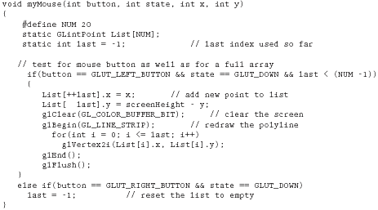


Slide 9
Mouse motion
Active mouse motion: Movement of mouse on the window when one of its button is pressed
handleActiveMouseMotion(int x, int y)
glutMotionFunc( handleActiveMouseMotion )
Passive mouse motion: Movement of mouse when no button is pressed
handlePassiveMouseMotion(int x, int y)
glutPassiveMotionFunc( handlePassiveMouseMotion )

Slide 10
Keyboard Interaction
Keys that are associated to some (single byte) ASCII code.
Make a function to do something on press of some key. It should receive an unsigned character for the key and the mouse location e.g.
handleNormalKeys(unsigned char key, int x, int y)
The function has to be registered with the operating system using
glutKeyboardFunc( handleNormalKeys )

Slide 11
Example…
Usual contents of the keyboard handler would be to check which key was pressed and react to it.
For example, having 27 as ASCII code for ESC:
if (key == 27)
...
if (key == ’c’)
…

Slide 12
void myKeyboard(unsigned char theKey, int mouseX, int mouseY)
{
GLint x = mouseX;
GLint y = screenHeight - mouseY; // flip y value switch(theKey)
{case ‘d’:
drawDot(x, y);
break;
// draw dot at mouse position
case ‘E’:
exit(-1); //terminate the program
default: break; // do nothing
}
}

Slide 13
Special Keys
Keys that are not represented in the ASCII table e.g. function and arrow keys. These have code of two bytes each.
Similar to normal keys, make a function to do something on press of the required keys. It should receive an integer for the key and the mouse location e.g.
handleSpecialKeys(int key, int x, int y)
This function has to be registered with the operating system using
glutSpecialFunc( handleSpecialKeys )

Slide 14
The key parameter can have one of the following values:
GLUT_KEY_F1 to GLUT_KEY_F12 for function keys
GLUT_KEY_LEFT, GLUT_KEY_RIGHT, GLUT_KEY_UP, and GLUT_KEY_DOWN
for arrow keys
GLUT_KEY_PAGE_UP, GLUT_KEY_PAGE_DOWN, GLUT_KEY_HOME, GLUT_KEY_END, GLUT_KEY_INSERT
Additionally status of the special keyboard keys can also be tested using
int key = glutGetModifiers( );
The returned value can be one of
GLUT_ACTIVE_SHIFT, GLUT_ACTIVE_CTRL, GLUT_ACTIVE_ALT

Slide 16
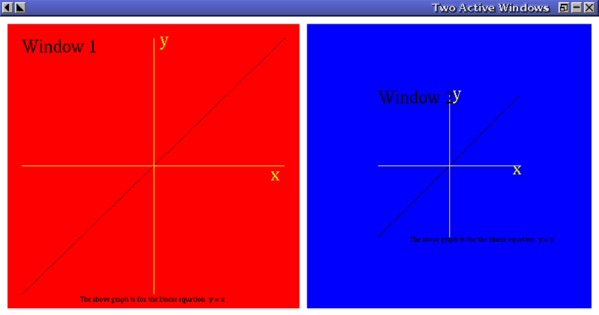
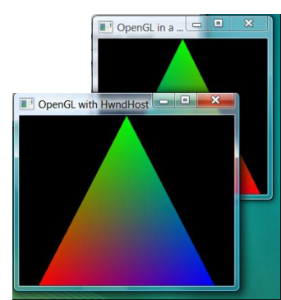
Windows and Displays

Slide 17
Window management
There can exist parallel and sub-windows under the same OpenGL program
A new window can be created using
int id = glutCreateWindow(“Window Title”);
A window can be activated using
glutSetWindow( id )
The drawing commands affect the currently active window
Each window can have different display properties. The display properties
(using glutInitDisplayMode()) can be set before creating a new window

Slide 18
Behavior of Callback Functions
Keyboard and mouse events are routed by the event loop to the callbacks registered for the window in which the cursor is located.
Display events generated for each window separately
when the O/S determines that the window must be redisplayed.
Display events can be user generated using glutPostRedisplay().
These events are routed to the display callback for the current window.
The shared idle() function is executed whenever
no events are present in the event queue.

Slide 19
Example Using Two Windows
glutInitDisplayMode(GLUT_DOUBLE | GLUT_RGB |GLUT_DEPTH);
glutInitWindowSize(500, 500);
// create the first window
window1 = glutCreateWindow("First Window - Perspective View");
// register callbacks for first window, which is now current
glutReshapeFunc(window1_reshape);
glutDisplayFunc(window1_display);
glutMouseFunc(window1_mouse);

Slide 20
//define a window position for second window
glutPositionWindow(520,20);
// register callbacks for second window, which is now current
glutReshapeFunc(window2_reshape);
glutDisplayFunc(window2_display);
glutMouseFunc(window1_mouse); //note we share the mouse function
glutIdleFunc(spinCube); //idle function is not associated with a window
//create the second window
window2 = glutCreateWindow("Second Window - Top/Down View");
glutMainLoop();

Slide 21
Display management
A display controller function is registered with the operating system using
glutDisplayFunc( displayController )
A function can made that should handle situations when the window gets reshaped. This function is registered using
glutReshapeFunc( reshapeHandler )
A function that should keep doing something during the system waits for any keyboard or mouse action from the user is registered as idle callback using
glutIdleFunc( doWhenIdle))

Slide 22
glutPostRedisplay(): Screen Refreshing
In order to activate the display controller function deliberately glutPostRedisplay() can called any time.
This helps refreshing the screen for example while showing animations.
A window ID can be given as parameter to refresh a specific window
The ultimate effect of this function is to call your Display callback for the current window .

Slide 23
Menu Driven User Interface

Slide 24
Menu Driven User Interface
Creating menus to interact with the user involves the following tasks
Step 1: Define the actions to be performed on selected of each menu item in a function
Step 2: Register this function as call back function associated to the menue
Step 3: Link the menu to a particular mouse button
There can exist many menus in a program

Slide 25
Example:
int main_menu =glutCreateMenu( processMenuItems );
void glutAddMenuEntry(“WOMEN", 1);
void glutAddMenuEntry(“MEN", 2);
void glutAddMenuEntry(“KIDS", 3);
Void glutAttachMenu(GLUT_RIGHT_BUTTON);
Notes:
This menu will appear when right mouse button is clicked. 1, 2, or 3 will be passed to
mainMenuFunction depending upon the selected option.

Slide 26
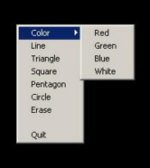
The menu callback function may look like this:
void processMenuItems(int id) {
switch (id) {
case 1 :
WOMEN();
BREAK
. . .
case 2 :
MEN ();
BREAK;
. . .
case 3 :
KIDS();
BERAK
exit(0);
}
}

Slide 27
Sub menues
For the same menu function, the menus could be made heirarchical:
int submenu = glutCreateMenu( processMenuItems );
glutAddMenuEntry("Item-1", 1);
glutAddMenuEntry("Item-2", 2);
int main_menu= glutCreateMenu( processMenuItems );
glutAddSubMenu("Items", submenu);
void glutAddMenuEntry("Quit", 3);
void glutAttachMenu(GLUT_RIGHT_BUTTON);

Slide 28
Detach Menus
void glutDetachMenu(int button); Parameters: button - the button to detach
The button parameter takes the same values as for the glutAttachMenu

Slide 29
static int window; static int menu_id; static int submenu_id;
static int value = 0;
void menu(int num){ if(num == 0){
glutDestroyWindow(window); exit(0);
}else{ value = num; }
glutPostRedisplay();
}
void createMenu(void){
submenu_id = glutCreateMenu(menu);
glutAddMenuEntry("Sphere", 2);
glutAddMenuEntry("Cone", 3);
menu_id = glutCreateMenu(menu);
glutAddMenuEntry("Clear", 1);
glutAddSubMenu("Draw", submenu_id);
glutAddMenuEntry("Quit", 0);
glutAttachMenu(GLUT_RIGHT_BUTTON);
}
void display(void){
glClear(GL_COLOR_BUFFER_BIT);
if(value == 1){
return; //glutPostRedisplay();
}else if(value == 2){
glPushMatrix();
glColor3d(1.0, 0.0, 0.0);
glutWireSphere(0.5, 50, 50);
glPopMatrix();
}else if(value == 3){
glPushMatrix();
glColor3d(0.0, 1.0, 0.0);
glRotated(65, -1.0, 0.0, 0.0);
glutWireCone(0.5, 1.0, 50, 50);
glPopMatrix();
}else if(value == 4){
glPushMatrix();
glColor3d(0.0, 0.0, 1.0);
glutWireTorus(0.3,0.6,100,100);
glPopMatrix();
} }
glFlush();
}

Slide 30
int main(int argc, char **argv){ glutInit(&argc, argv);
glutInitDisplayMode(GLUT_RGBA | GLUT_SINGLE);
glutInitWindowSize(500,500);
glutInitWindowPosition(100,100);
window = glutCreateWindow("Menus and Submenus - Programming Techniques");
createMenu();
glClearColor(0.0,0.0,0.0,0.0);
glutDisplayFunc(display); glutMainLoop();
return EXIT_SUCCESS;
}

